Slide 1

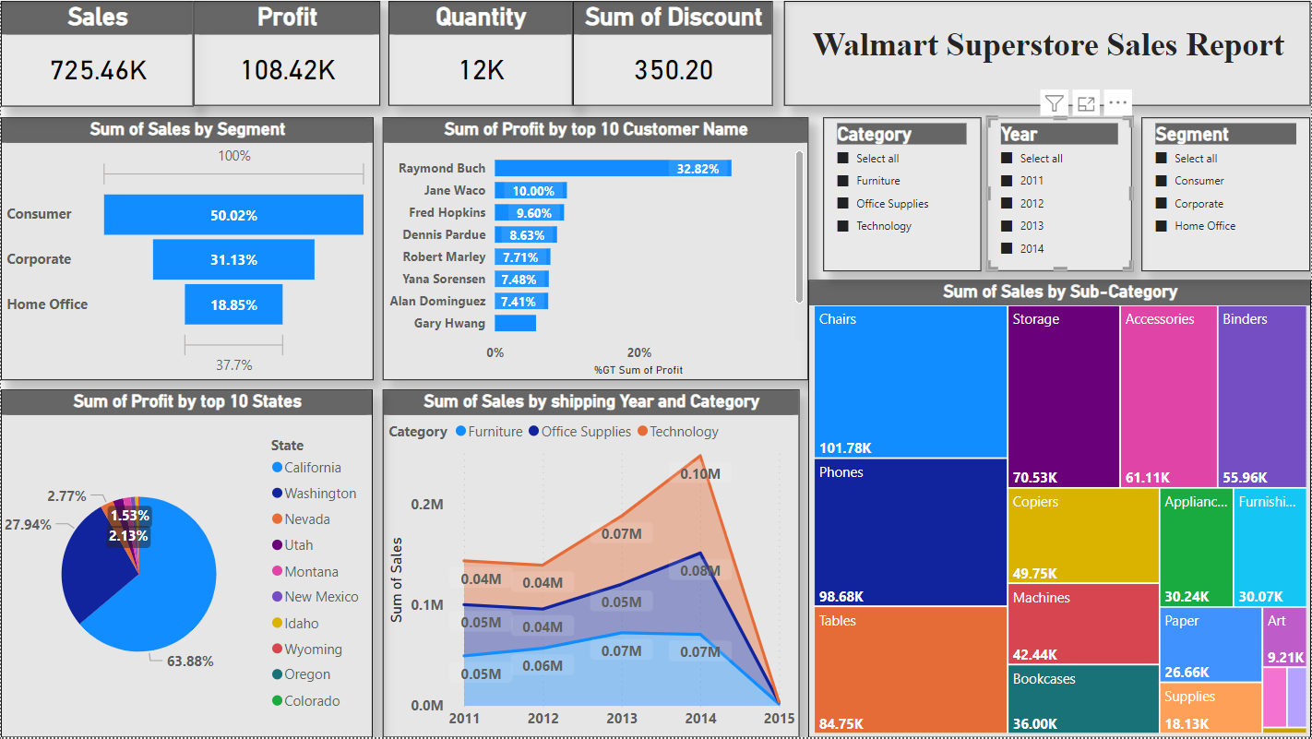
Walmart Superstore Sales Analysis
Summary
Analysed the Walmart super store data and found the maximum profit by the store has been increased gradually and consumer segment has played a topper role for the profit margin followed by corporate and home office segments.

Slide 2
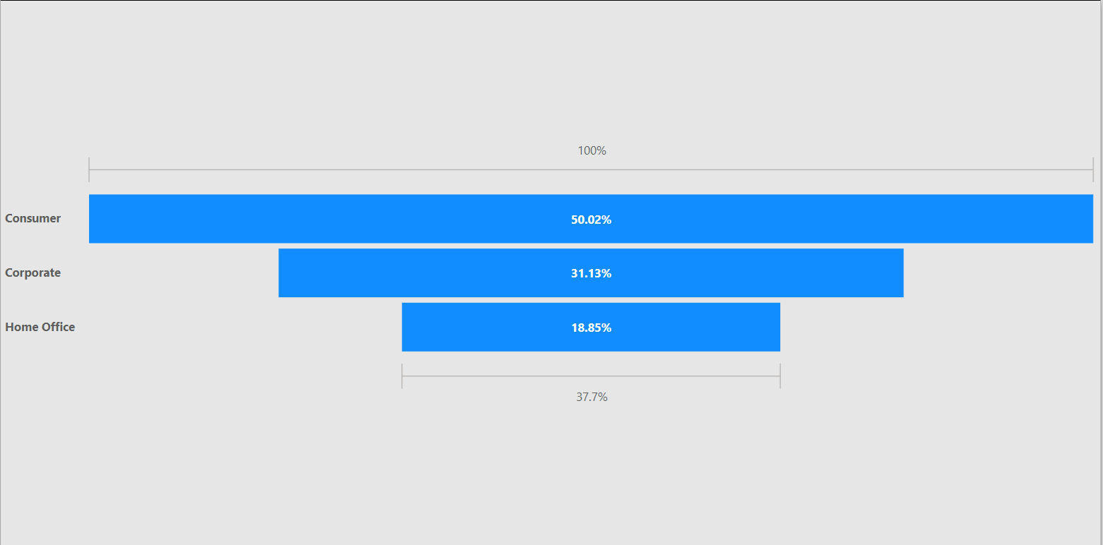
Observation 1
As per the analysis on the basis of Segment, Consumer segment is the most selling components with the percentage of 50.02% in all four years from 2011 to 2014, which reaches half of the sales volume. And followed by corporate with 31.13% and home office category with 18.85%.

Slide 3
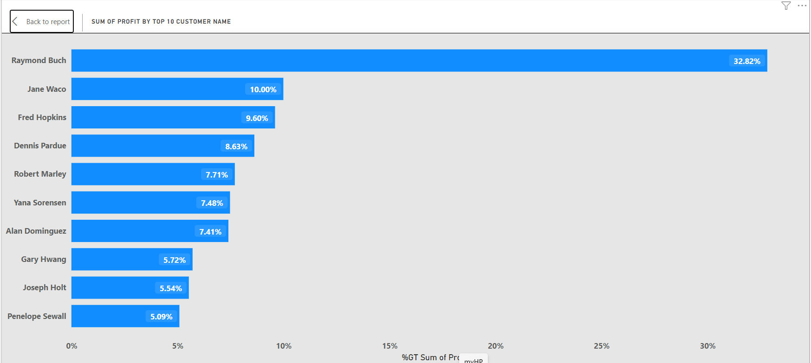
Observation 2
As per the observation below are the top 10 customer which helps the store increasing the profit. As per analysis the profit from the customers are gradually increases in all four years from 2011 to 2014. And at the same consumer products hits the most profitable category.

Slide 4
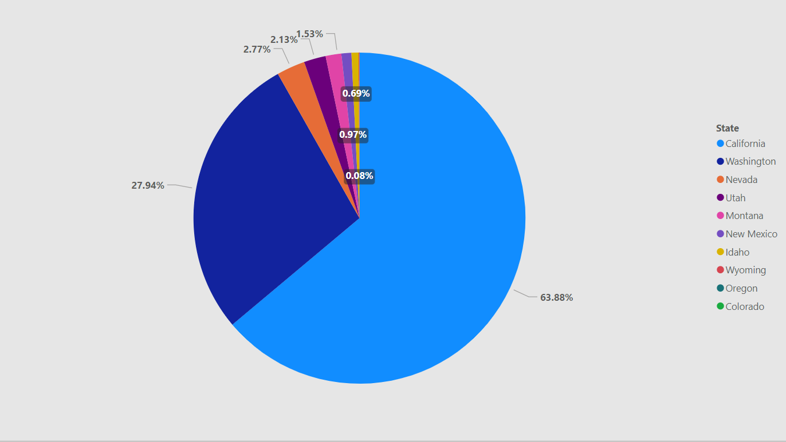
Observation 3
As per the below observation the store gets maximum profit from California state with the percentage of 63.88% and the result is from the consumer segment.

Slide 5
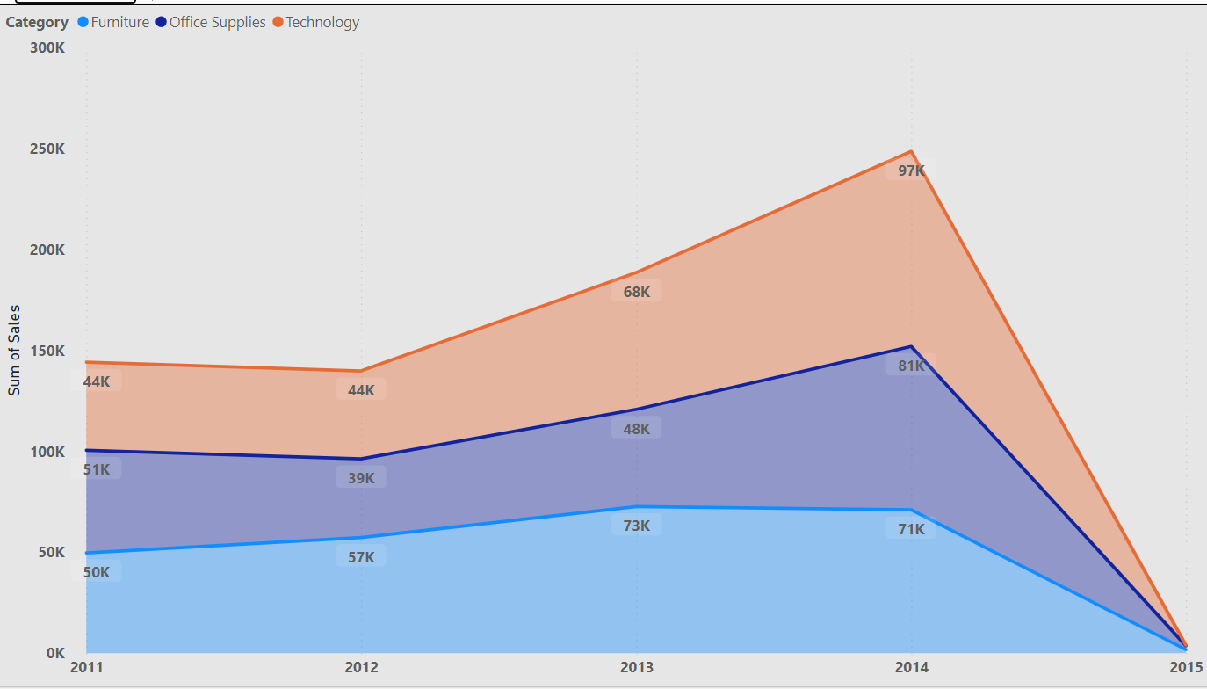
Observation 4
As per the below observation in the maximum sales reaches to $0.10M in the Year 2014 and the maximum sales happened in the technology category for all 5 years from 2011 to 2015.

Slide 6
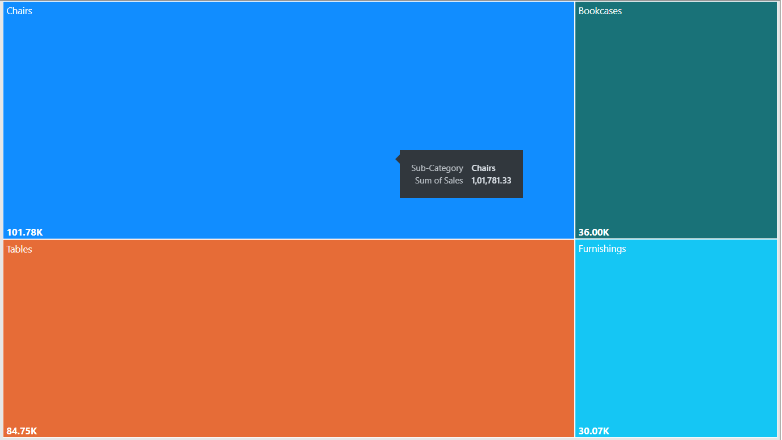
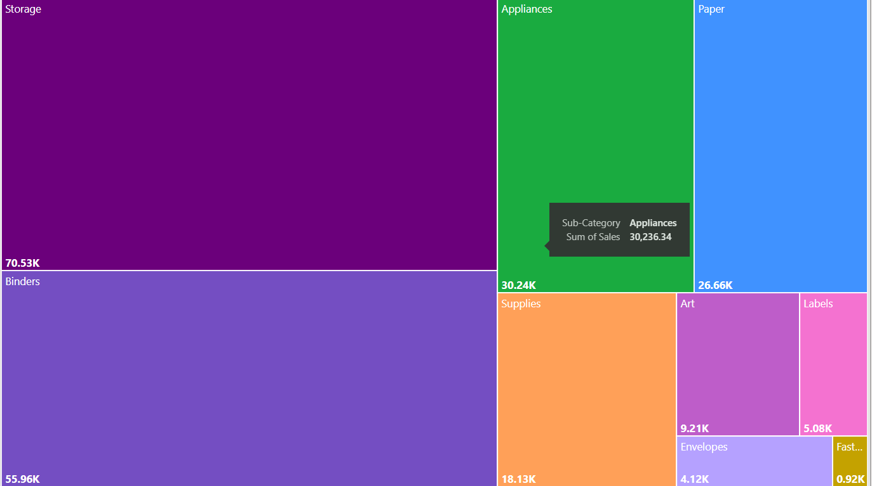
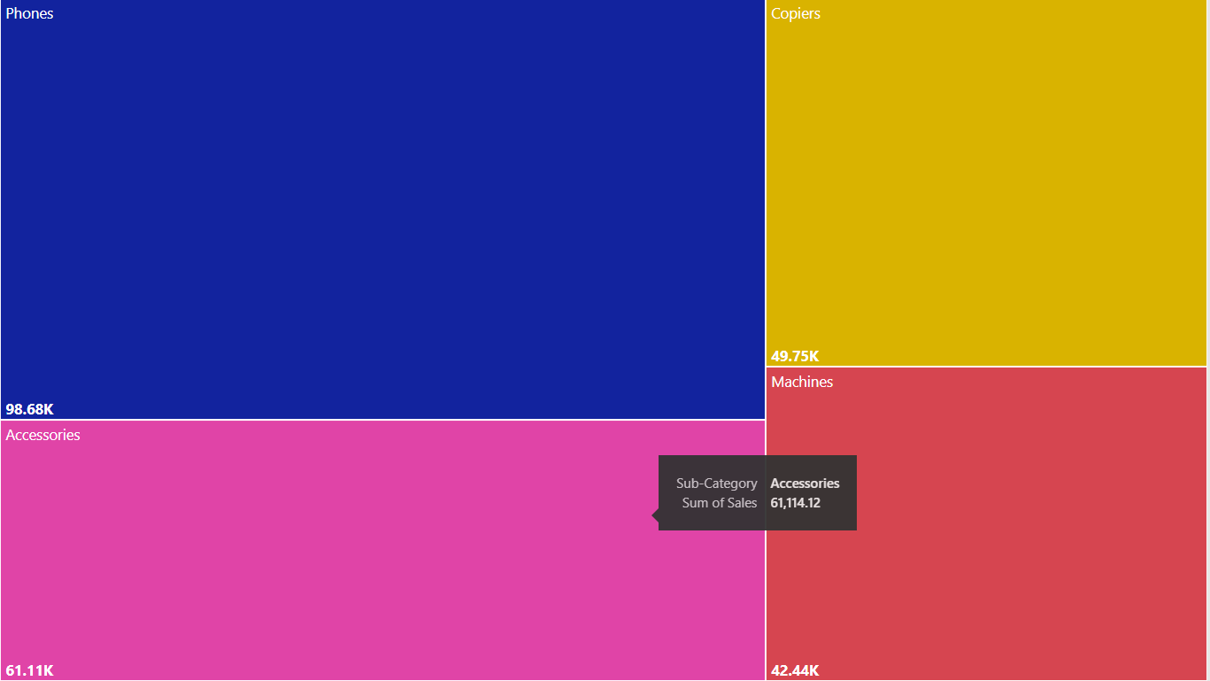
Observation 5
Below observation states about the category vise profit, in Furniture category the profit value is $11.50k, by office supplies category the profit value is $52.61k followed by technology category which profit value is $44.30k
Furniture category
Office supplies
Technology

Slide 7
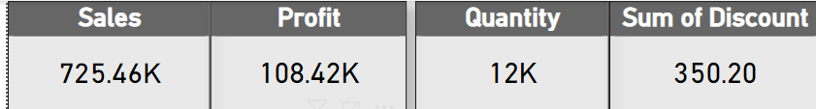
Observation 6
Below results states the overall sales, profit, quantity and discount provided by the store
Conclusion:
Bases on the analysis the home office segment has to be concentrated to increase their profit margin
California and Washington states provides maximum profits of the store so concentrating on the development of stores in other states will help us to increase the profit as well.
Thank You
Aswin A

